Slide 1
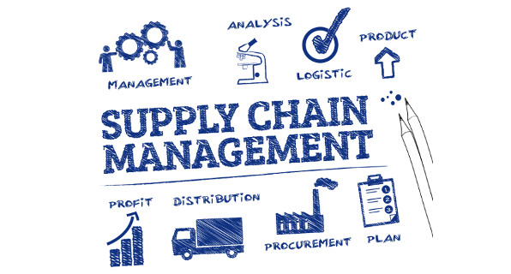

SUPPLY CHAIN MANAGEMENT
Analysis, Optimization & Strategic Insights
Tools & Technologies:
📊 Excel 📈 Power BI 🧠 Python 📦 SQL
Presented By –
Mitali Sharma
Bolerao Ramya
Fathima Saina Ajumal
Santosh Kumar
Ambati Manohar Reddy
Monika Kodavati

Slide 2
📌 Supply Chain Management Project – Summary
Analyzed key supply chain components with a focus on Inventory Management, procurement, logistics, and demand trends.
Data cleaned and prepared using Excel and MySQL for accurate analysis.
Conducted insights on inventory levels, stockouts, lead times, warehouse utilization, and supplier performance.
Identified bottlenecks and improvement opportunities to reduce costs and enhance process efficiency.
Built interactive dashboards using Power BI, Tableau, and Excel to visualize major KPIs:
  Inventory Turnover
  Order Cycle Time
  Forecast Accuracy
  Logistics & Operational Costs
Enabled data-driven decision making through clear insights and visual analytics.
Showcased how analytical tools improve supply chain visibility, optimize inventory processes, and support strategic planning.

Slide 3
KPI’s used
( Supply CHAIN ) ( INVENTORY )
Total Sales
Total Quantity Sold
Gross Profit
Profit Margin %
Average Selling Price
Total Products Sold
Average Sales per Product
Inventory Value
Stock Turnover Ratio
Top Product Family
Total Customers
Active Loyalty Members
Average Customer Age
Repeat Customer %
Customer Lifetime Value (CLV)
Total Stores
Average Monthly Sales per Store
Average Rent Cost
Online vs Offline Sales %
Average Employee Productivity
Fill Rate %
Forecast Accuracy %
Average Order Processing Time (Days)
% Orders Shipped Late
Average Delay Days
Total Orders
Total Stock On Hand
Total Reorder Level
Number of SKUs Below Reorder Level
Average Lead Time (Days)
Stock Coverage (Days)
Total Procurement Cost
Average Lead Time
On-Time Supply %
Total Transportation Cost
Average Transportation Cost per Order
Carrier On-Time %
Average Delay by Carrier
Forecast Accuracy %
Bias %
Average Fill Rate %
Forecast Error (Units)
Total Inventory Value
Total SKUs
Low Stock Items
Inventory Turnover Ratio
Current Stock per SKU
Stock Value per SKU
Reorder Status
Stock Movement
Stock Coverage (Days)
Total Purchase Value
Average Lead Time
Supplier On-Time %
Pending Purchase Orders
Total Sales Value
Gross Profit
Stock-Out Count
Backorder %
Top-Selling Products
Inventory Aging (Days)
Reorder Point (ROP)
Safety Stock
Forecasted Demand
Inventory Value Trend

Slide 4
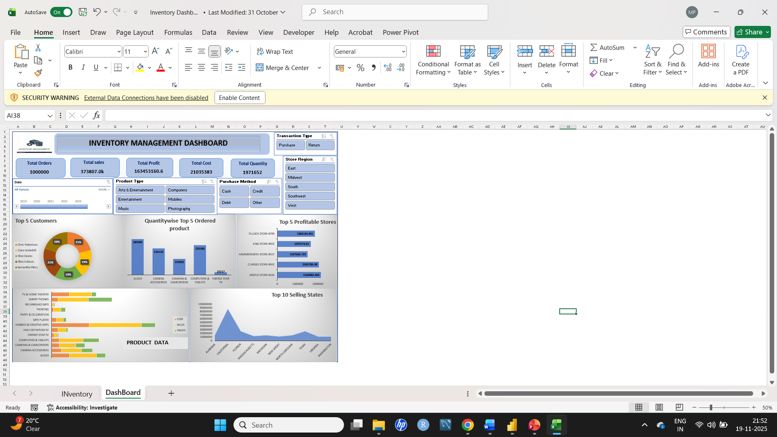
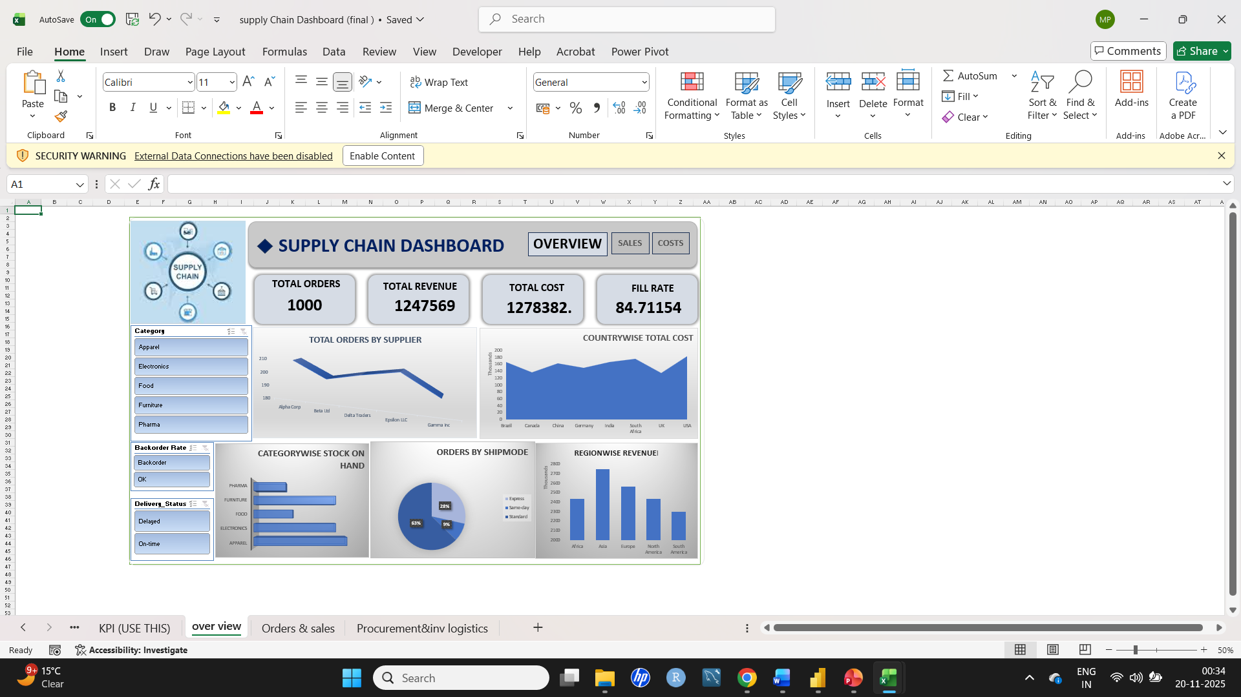
M.S. Excel

Slide 5
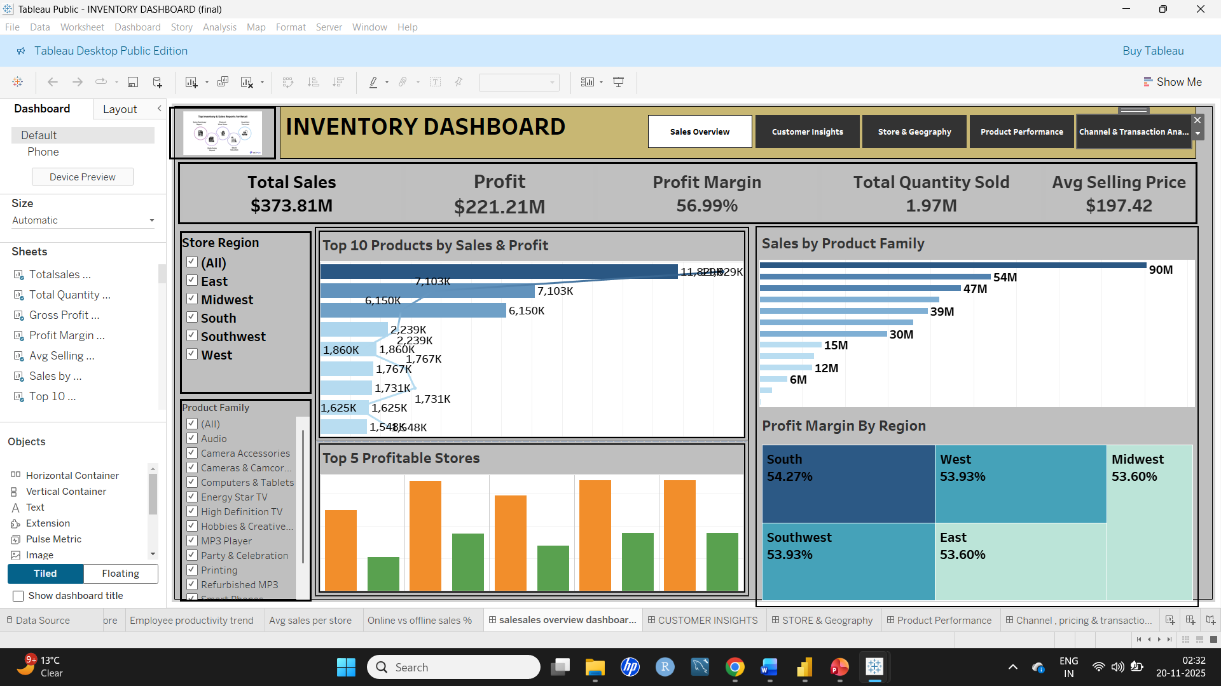
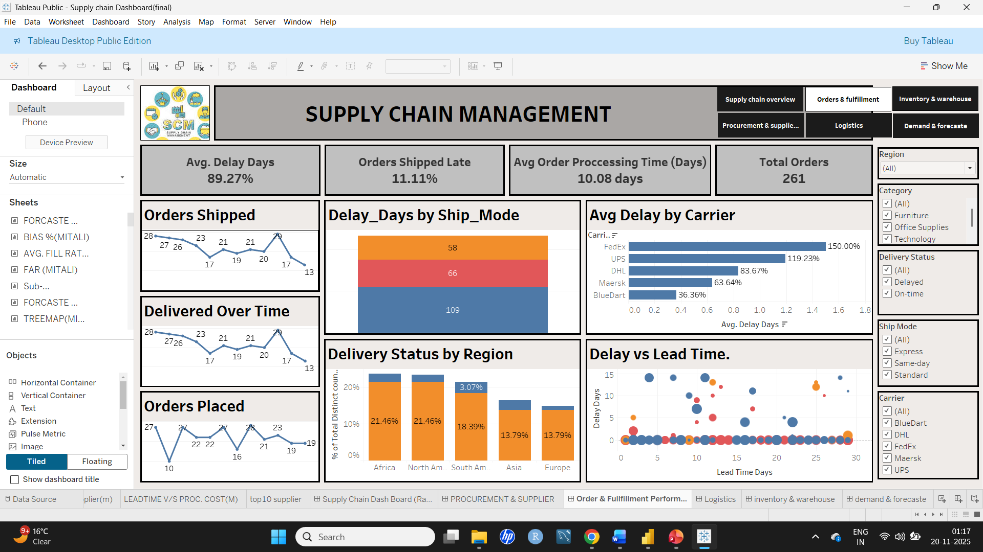
TABLEAU

Slide 6
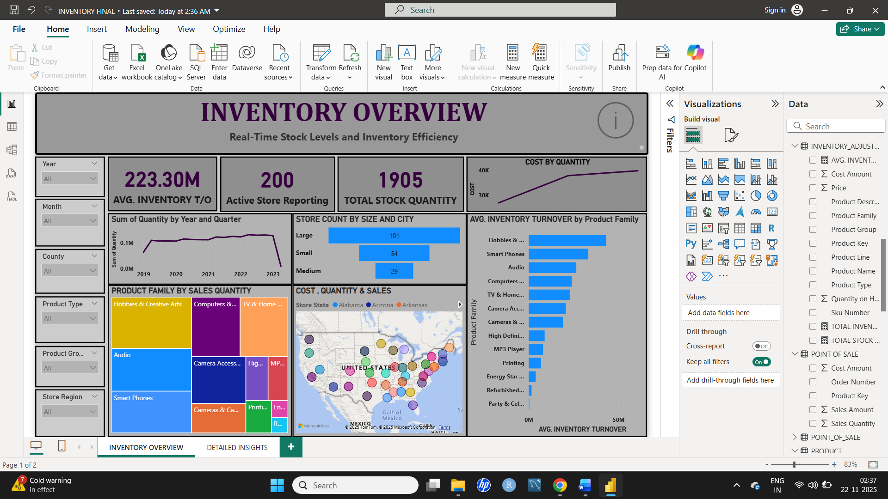
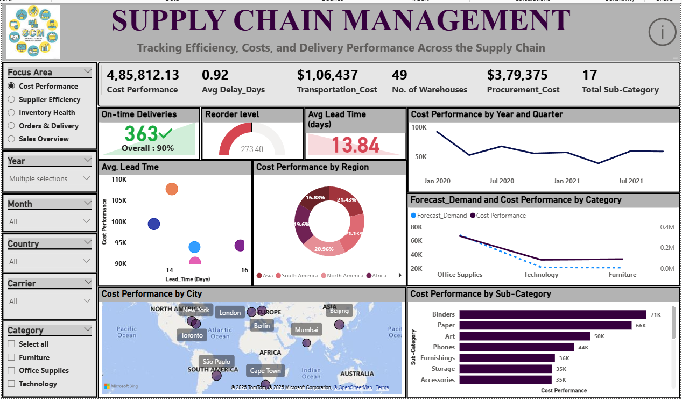
POWER Bi

Slide 7
SQL
INVENTORY
SUPPLY CHAIN MGT.

Slide 8

Essential Takeaways :
📦 Supply Chain Fundamentals
Understood end-to-end flow: Procurement → Inventory → Sales → Logistics
Learned key SCM KPIs: Lead Time, Fill Rate, Stock Turnover, Forecast Accuracy
🧹 Data Preparation & Modelling
Cleaned, merged, and standardized data using Excel & MySQL
Designed a Relationships for smooth analytics and dashboard performance
📊 Dashboard & Tool Mastery
Built interactive dashboards in Power BI, Tableau, Excel
Used SQL queries for data extraction, validation, and metric creation
📈 KPI Analysis & Insights
Developed KPIs for sales, procurement, warehouse, and transportation
Strengthened ability to interpret data and highlight performance gaps
🧠 Business Impact & Decision-Making
Learned to translate data into actionable recommendations
Improved understanding of how analytics supports strategic planning

Slide 9

THANK YOU

